Slide 1

MOBILE AI / SEMINAR
AI AND
MACHINE LEARNING
IN MOBILE APPLICATIONS
Seminar on Mobile Application Development Technologies
Presented by: Param Parikh · Roll number: 12302080601093
Presented by: Devansh Prajapati · Roll number: 12302080601096
Faculty: Nayankumar Mali · College: ADIT
Notes:
Welcome everyone to this seminar on AI and machine learning in mobile applications. We will connect the basic ideas to tools, workflows, and familiar mobile experiences. The goal is to understand how intelligent features are built and why responsible design matters.

Slide 2




MOBILE AI / SEMINAR
THE SHIFT
MOBILE APPS ARE BECOMING MORE AWARE
See
Hear
AI helps apps understand images, faces, objects, and text. Camera enhancement and translation are examples.
AI helps apps understand speech and user intent; voice search turns speech into commands or text.
Assist
Sense context
Machine learning improves from examples, not only fixed rules, supporting recommendations. The goal is useful assistance without making users manage complexity.
Smart maps use location, movement, and changing conditions to guide users.
AI & ML IN MOBILE APPLICATIONS
NAYANKUMAR MALI
02 / 10
Notes:
Mobile apps are becoming more aware of the world around them. They can work with images, speech, text, location, and user intent. The important point is that the user experiences assistance, not the technical complexity behind it.

Slide 3
MOBILE AI / SEMINAR
AI IS THE BIG IDEA. ML IS ONE WAY TO BUILD IT.
Artificial intelligence is the wider goal; machine learning is a major method inside it.
Machine Learning
Artificial Intelligence
A method that learns patterns from examples to make predictions or decisions.
Simple example: a spam filter learns from labeled messages and predicts whether a new message is spam.
Software that performs tasks associated with human intelligence, such as understanding language, recognizing images, or making decisions.
AI & ML IN MOBILE APPLICATIONS
NAYANKUMAR MALI
03 / 10
Notes:
AI describes the broad idea of software doing tasks that we associate with human intelligence. Machine learning is one important way to create those abilities. A spam filter is a simple example because it learns patterns from labeled messages and then predicts what a new message means.

Slide 4
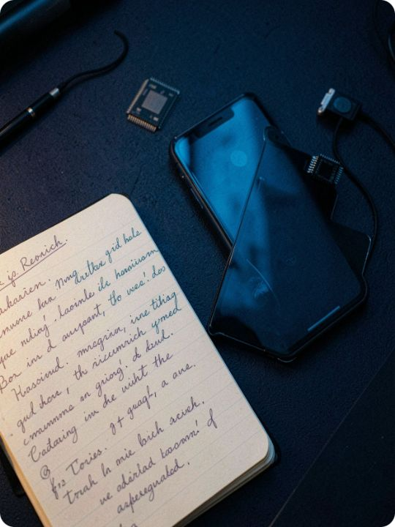
MOBILE AI / SEMINAR
A SHORT HISTORY
AI MOVED FROM LAB EXPERIMENTS TO POCKET DEVICES
1
2
3
4
5
Rules
Statistics
Smartphones
Deep learning
Today
Early AI research focused on symbolic rules and problem solving.
Data-driven prediction became more practical.
Smartphones added cameras, sensors, microphones, and powerful chips.
Deep learning improved vision, speech, and language features.
Mobile apps combine on-device models, cloud services, and generative AI.
AI & ML IN MOBILE APPLICATIONS
NAYANKUMAR MALI
04 / 10
Notes:
This is a technology progression, not a list of dates to memorize. AI began with rules and problem solving, then moved toward statistical learning. Smartphones supplied sensors and specialized chips, while deep learning improved vision, speech, and language features. Today, mobile apps can combine device models, cloud services, and generative AI.

Slide 5
MOBILE AI / SEMINAR
WE USE MOBILE AI EVERY DAY
Face detection helps cameras focus and organize photos.
Voice assistants convert speech into commands or text.
Maps estimate routes and adapt to changing conditions.
Translation and image recognition help users understand unfamiliar content.
Recommendation systems personalize music, shopping, video, and news feeds.
AI & ML IN MOBILE APPLICATIONS
NAYANKUMAR MALI
05 / 10
Notes:
Most people already use mobile AI without calling it AI. Cameras detect faces, voice assistants interpret speech, and maps estimate routes. Translation, image recognition, and recommendation systems are also everyday examples.

Slide 6
MOBILE AI / SEMINAR
A MODEL LEARNS BEFORE THE APP MAKES A PREDICTION
Collect: gather representative examples and define the target task.
Train: adjust model parameters using training data.
Test: check performance on data the model did not see during training.
Integrate: package the model and connect it to the mobile app.
Predict: process new input and return a result to the user.
AI & ML IN MOBILE APPLICATIONS
NAYANKUMAR MALI
06 / 10
Notes:
A prediction begins long before the user sees an answer. First, examples are collected and the task is defined. The model is trained and tested, then integrated into the app. Only after that does it process new input and return a prediction.

Slide 7

MOBILE AI / SEMINAR
THE MOBILE AI WORKFLOW HAS TWO MAIN ROUTES
User input → mobile application → AI/ML model → result
User Input
On-device
Processes input on the phone; useful for low latency, offline use, and keeping data local.
Mobile App
On-device Model
Cloud Model
Cloud-based
Sends data to a remote service; useful when a larger model or more compute is needed.
Choose by privacy, speed, connectivity, model size, cost, and task complexity.
AI & ML IN MOBILE APPLICATIONS
NAYANKUMAR MALI
07 / 10
Notes:
There are two common routes for mobile AI. An on-device model processes the input on the phone, which can reduce delay, support offline use, and keep data local. A cloud-based service can provide more computing power for larger models. The correct choice depends on the task and its privacy, speed, cost, and connectivity needs.

Slide 8
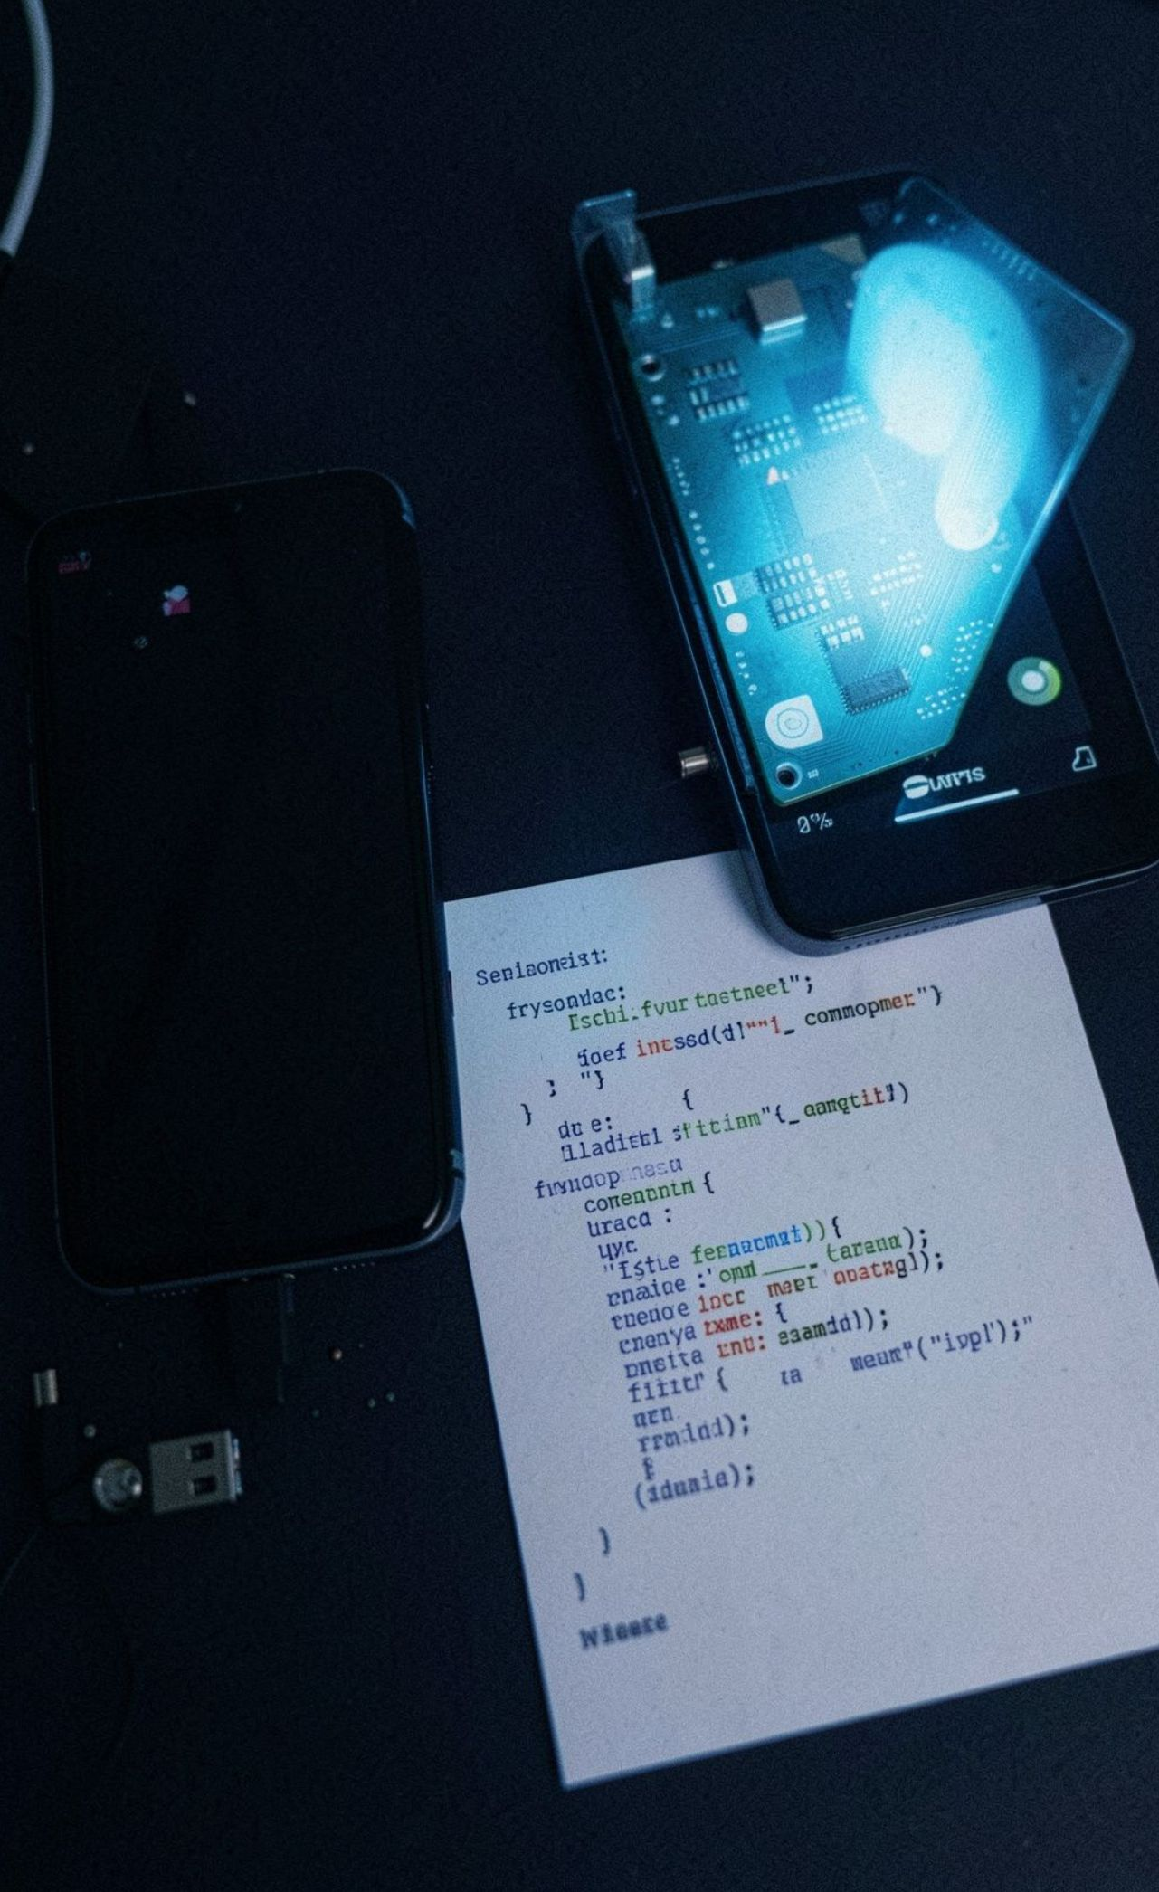





MOBILE AI / SEMINAR
THE TOOLCHAIN CONNECTS CODE, MODELS, AND DEVICES
Android Studio
Kotlin
Development environment for Android apps.
Modern language commonly used for Android development.
Swift
Python
Language for Apple platform development.
Common language for data preparation and model experimentation.
Google ML Kit
LiteRT and Apple Core ML
Ready-to-use mobile APIs for vision, text, barcode, face, and other tasks; processing can run on-device.
Deployment technologies for running optimized models on supported devices.
AI & ML IN MOBILE APPLICATIONS
NAYANKUMAR MALI
08 / 10
Notes:
The toolchain connects several kinds of work. Android Studio, Kotlin, and Swift support application development, while Python is common for preparing data and experimenting with models. Google ML Kit provides ready-to-use mobile APIs, and LiteRT and Apple Core ML help deploy optimized models on supported devices.

Slide 9
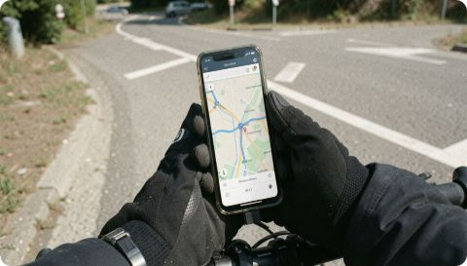
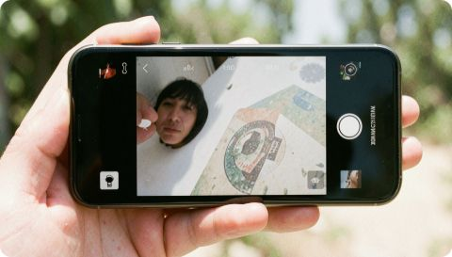
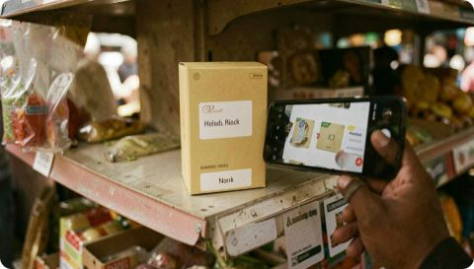
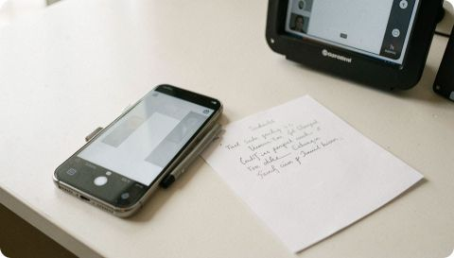
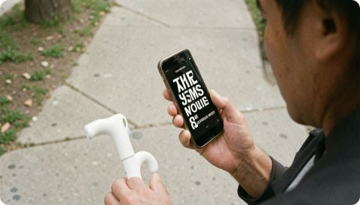
MOBILE AI / SEMINAR
MOBILE AI SOLVES SMALL, USEFUL PROBLEMS
Navigation: interpret location and movement data for route guidance.
Photography: detect faces, text, objects, or scenes to improve camera experiences.
Shopping: support visual search, product discovery, or personalized ranking.
Banking: assist with document capture, transaction review, or identity workflows.
Accessibility: convert speech to text, read visible text aloud, or describe visual content.
Every use case still needs testing, consent, error handling, and a human-friendly fallback.
AI & ML IN MOBILE APPLICATIONS
NAYANKUMAR MALI
09 / 10
Notes:
Useful mobile AI is often small and focused. It may guide a route, improve a photo, help someone search for a product, capture a document, or make visible content accessible. Each use case still needs testing, consent, error handling, and a fallback that helps the person when the model is wrong.

Slide 10
MOBILE AI / SEMINAR
THE BENEFIT IS SPEED.
THE RISK IS TRUST.
Benefits
Challenges
Personalization, automation, fast responses, offline support, and more accessible interfaces.
Privacy, security, biased data, inaccurate predictions, and hard-to-explain outputs.
Mobile limits
Responsible design
Battery use, memory, heat, network quality, and different device capabilities.
Measure errors, protect data, and give users control.
AI & ML IN MOBILE APPLICATIONS
NAYANKUMAR MALI
10 / 10
Notes:
Mobile AI can make an app faster, more personal, more accessible, and sometimes available offline. But speed does not automatically create trust. Designers must consider privacy, security, bias, inaccurate predictions, battery limits, and different devices. Responsible design measures errors, protects data, and keeps the user in control.

